Slide 1

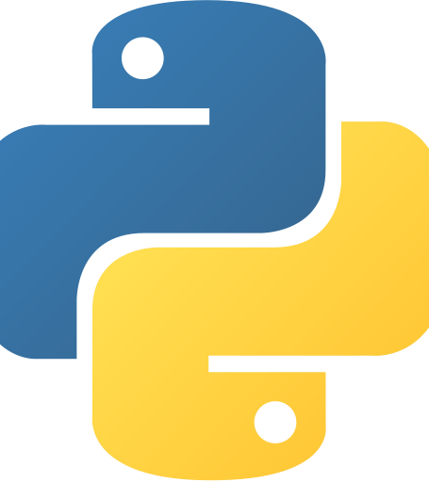
Topics in Programming Languages
Max Gelmadin & Lior Fradin

Slide 2
Python
Object Oriented
Procedural
Functional
Structured
Dynamically Typed
Strongly Typed
Garbage Collected

Slide 3
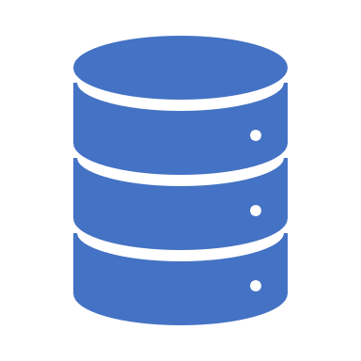
Database
Django supports numerous databases:
PostgreSQL
MariaDB
MySQL
Oracle
SQLite
About SQLite:
SQLite is a relational database management system (RDBMS) contained in a C library. In contrast to many other database management systems, SQLite is not a client–server database engine. Rather, it is embedded into the end program.
Why we decided to use SQLite in this
project:
Suitable for basic development and testing
Easy to use
Easily portable
When scalability becomes an issue, Django’s framework allows us to migrate very easily to a more advanced database such as MySQL.

Slide 4

About Django
Django is an open-source framework for backend web applications based on Python — one of the top web development languages. Its main goals are simplicity, flexibility, reliability, and scalability.
Django has its own naming system for all functions and components (e.g., HTTP responses are called “views”). It also has an admin panel (more details will be provided in further slides).
More technical features:
Simple syntax
Model-View-Controller core architecture
Object Relational Mapper
HTTP libraries
Python unit test framework

Slide 5
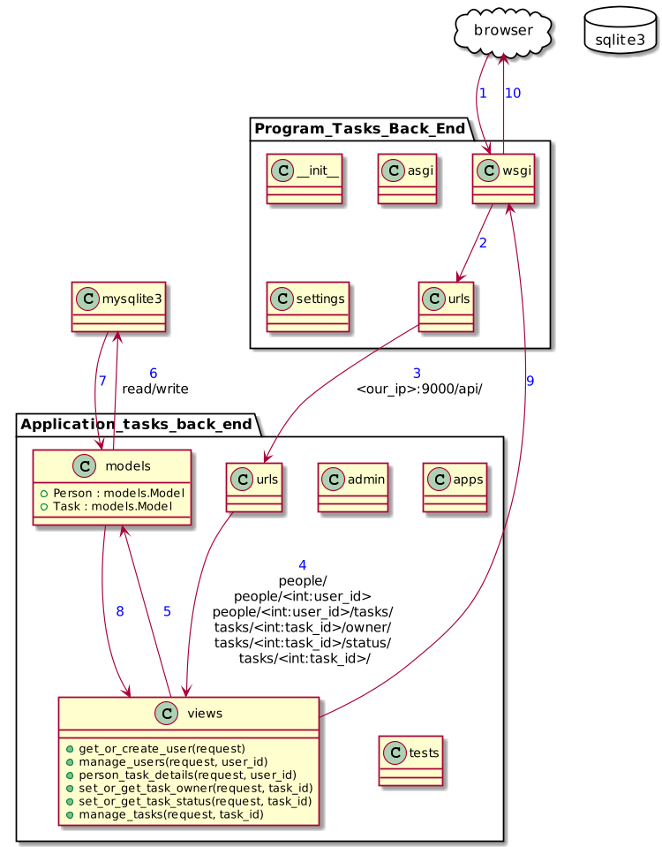
Flowchart of the Project

Slide 6

Diving into the code

Slide 7
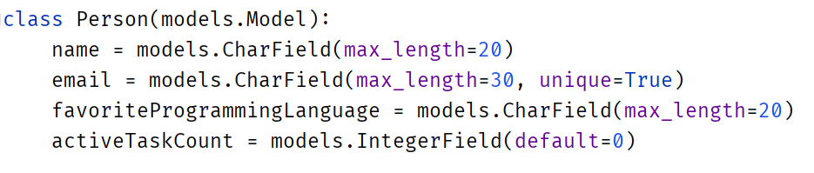
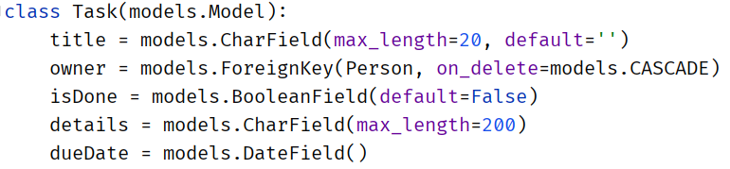
Models

Slide 8
Views

Slide 9
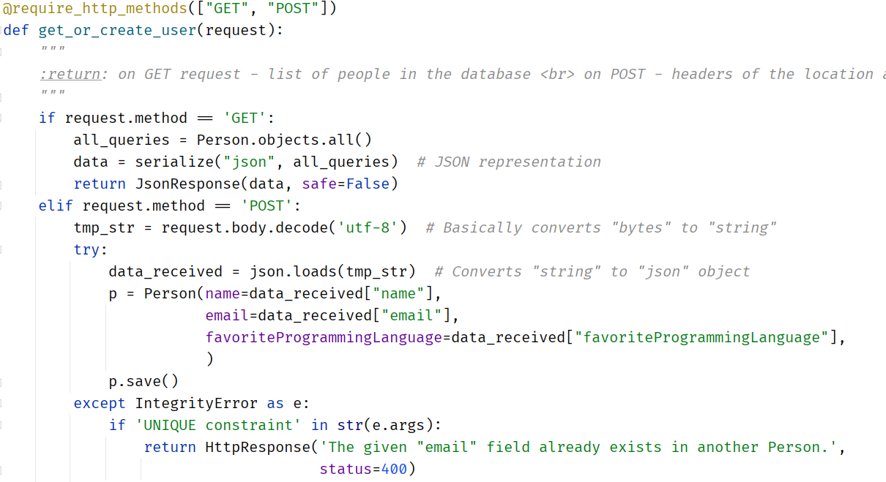
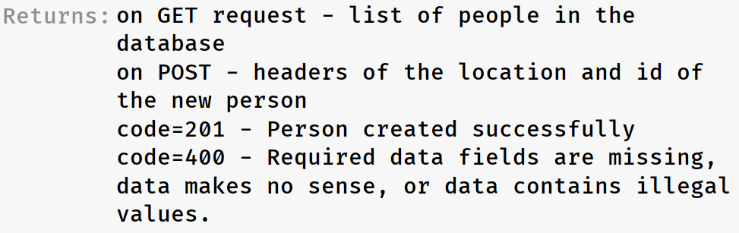
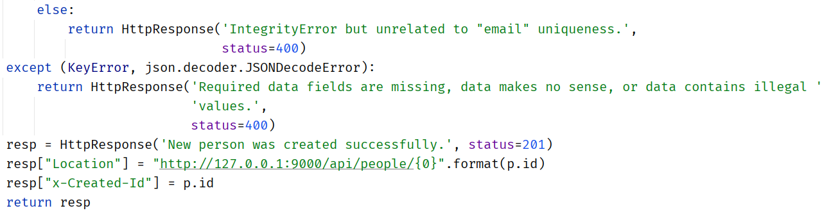
Extract or insert user into the database:

Slide 10
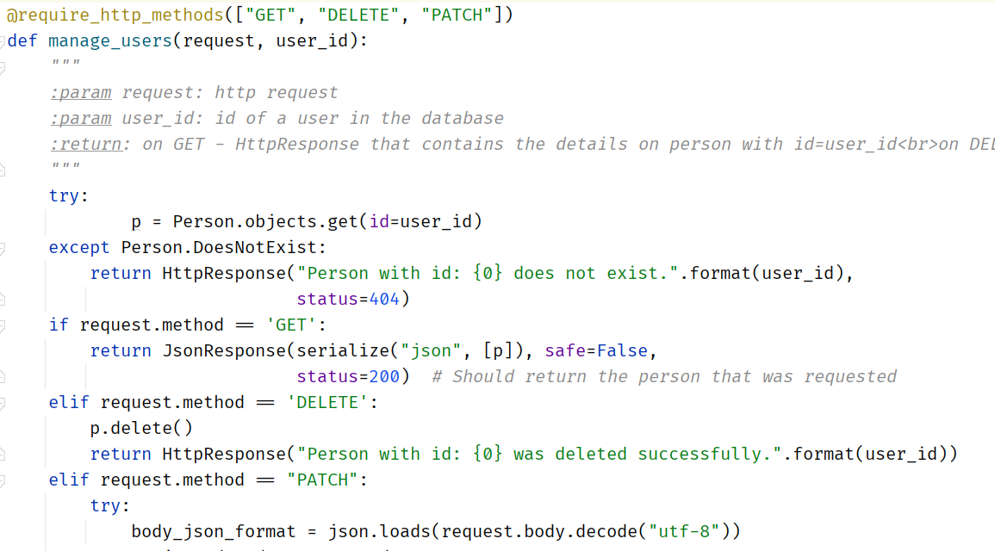
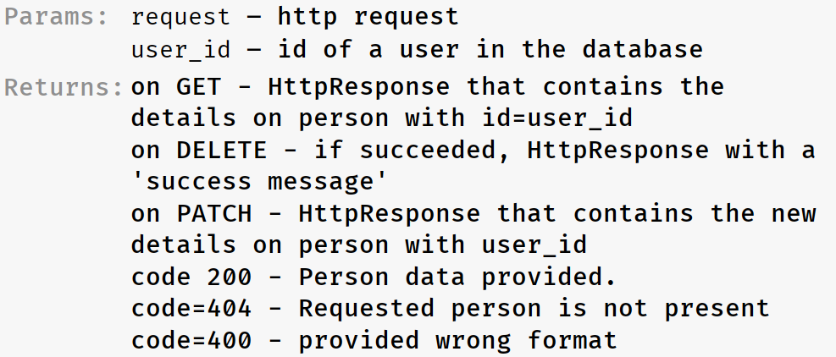
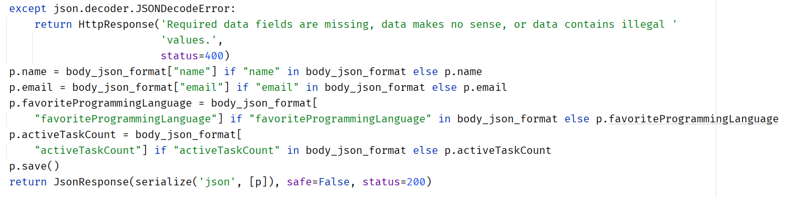
Manipulate User’s database

Slide 11
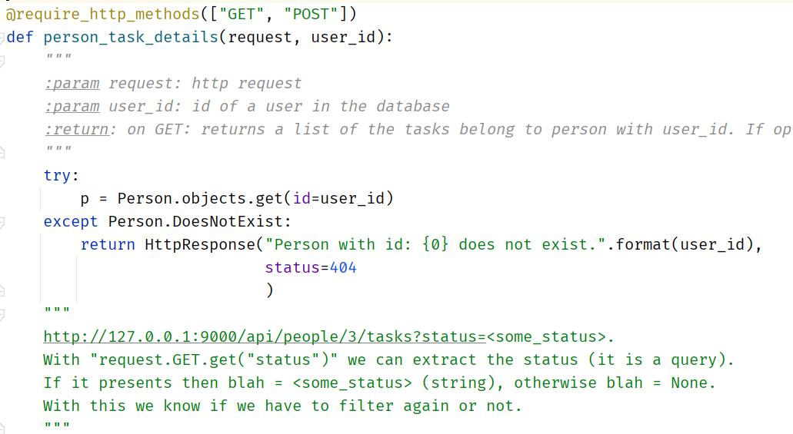
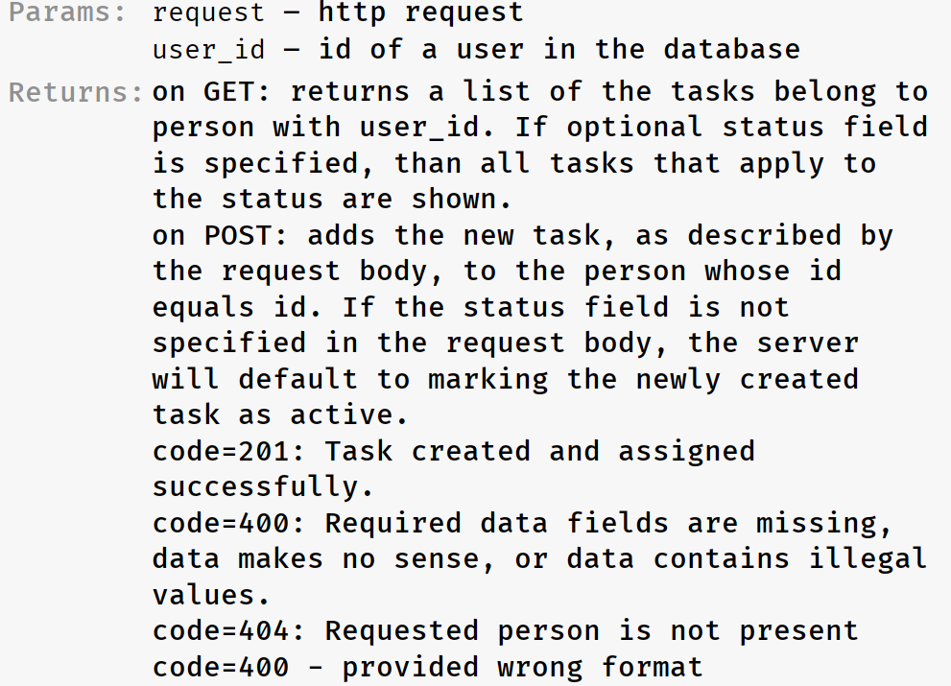
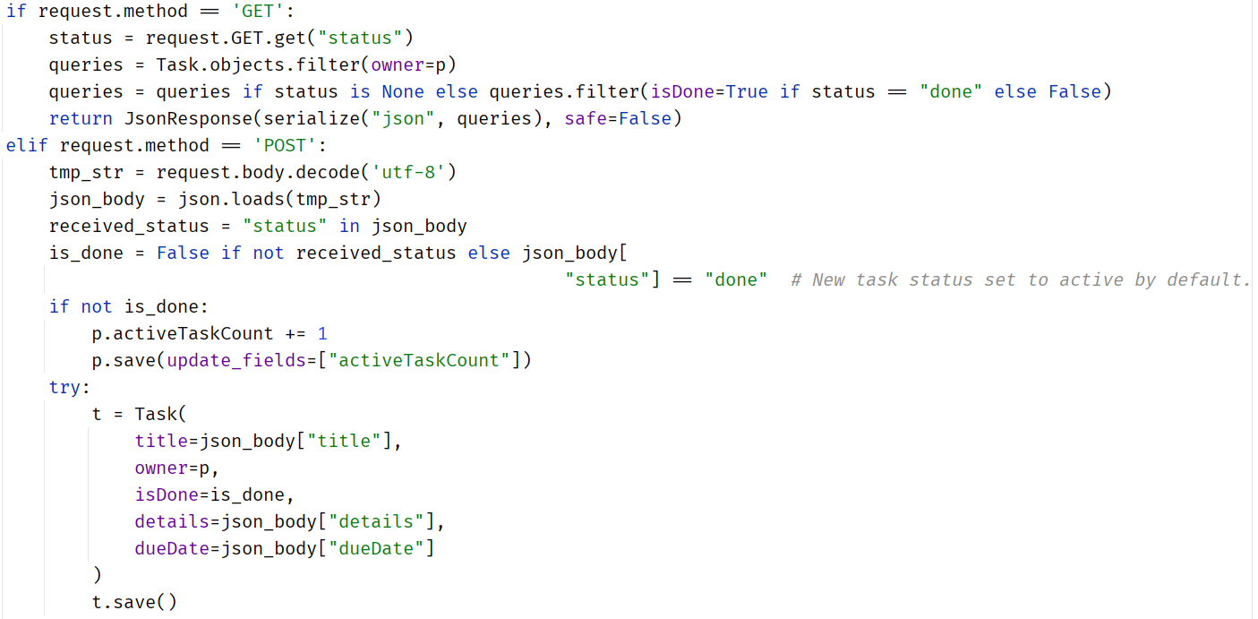
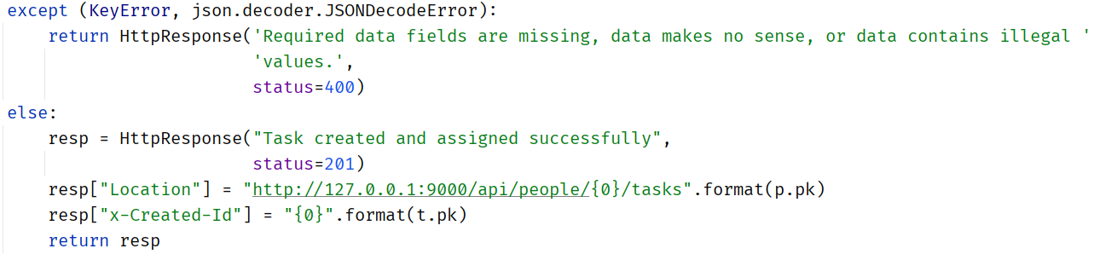
Add or view person’s tasks

Slide 12
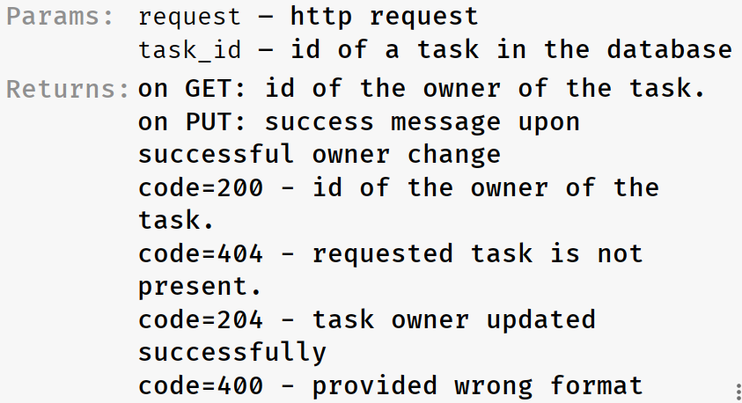
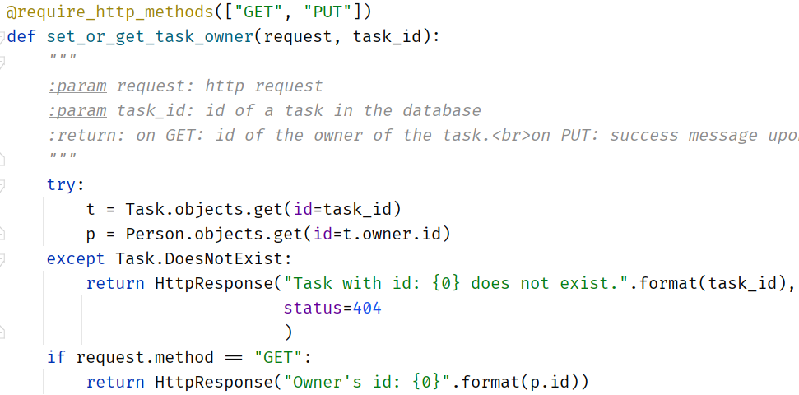
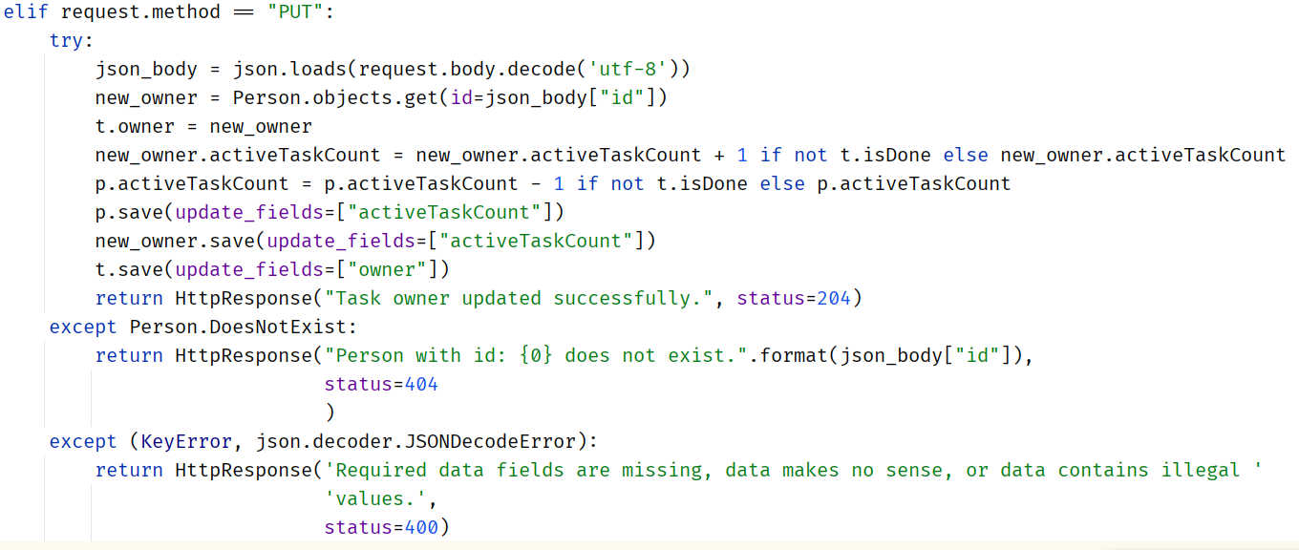
Update or extract the owner of a task

Slide 13
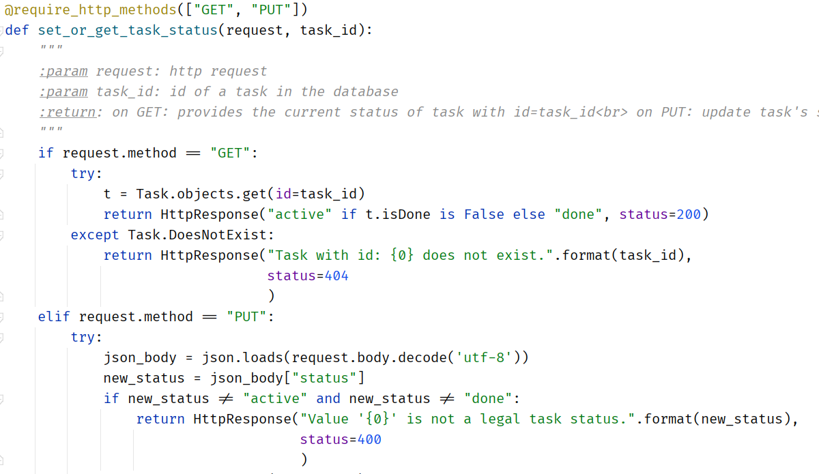
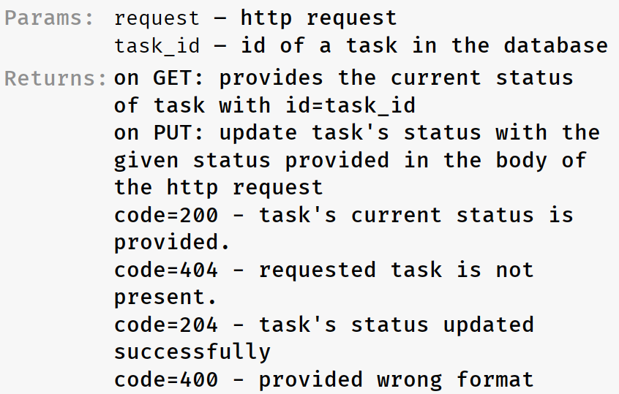
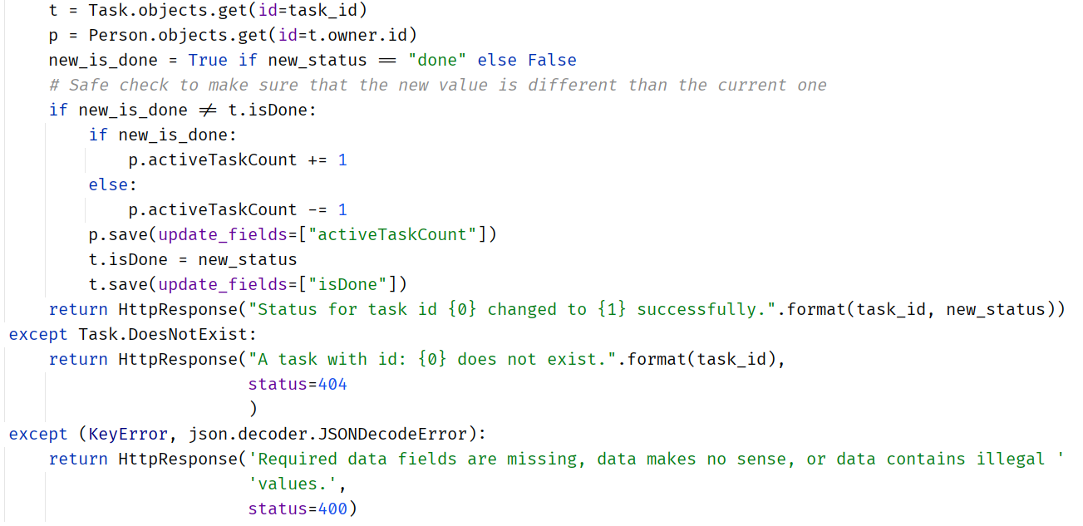
Extract or update a task’s status

Slide 14
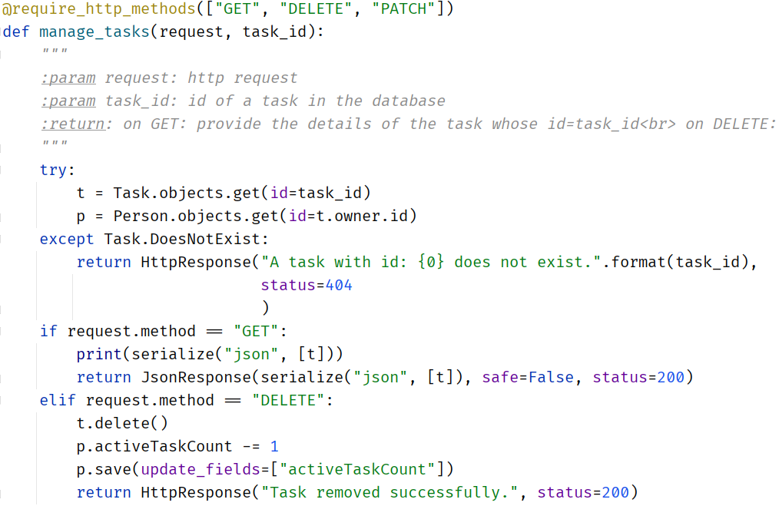
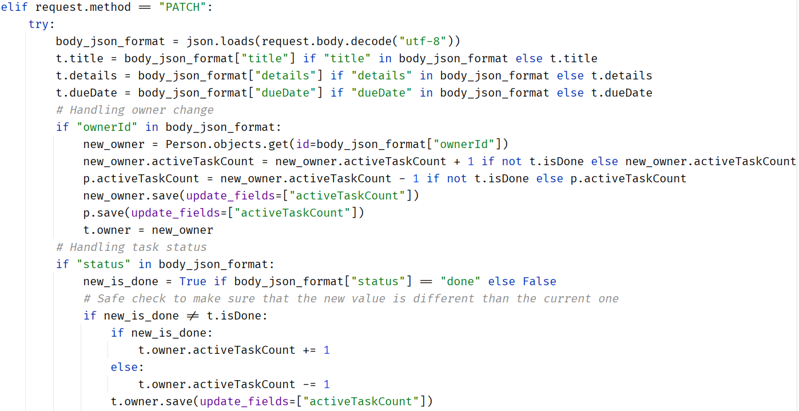
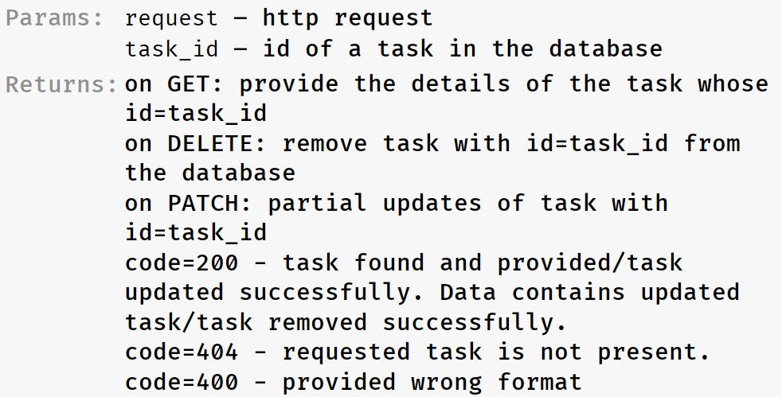
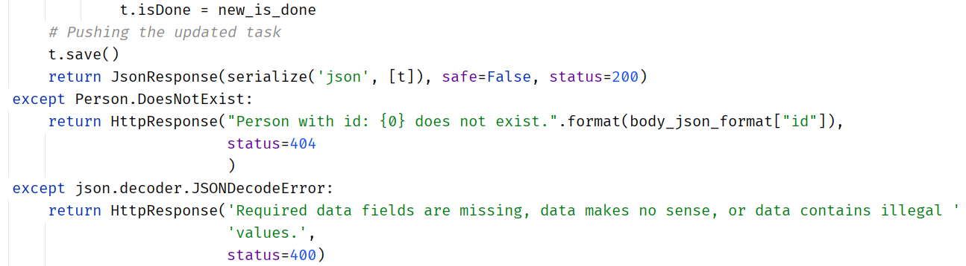
Manipulate Task’s database

Slide 15
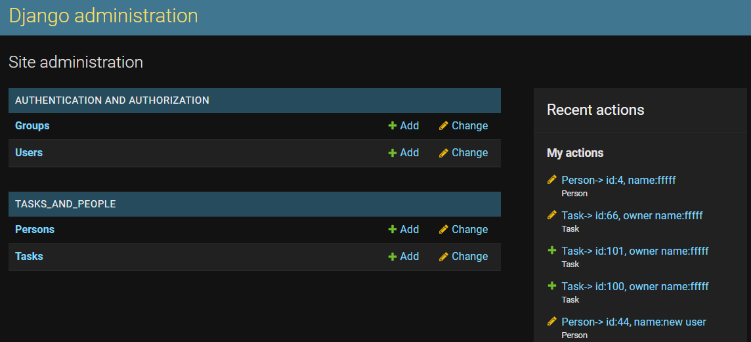
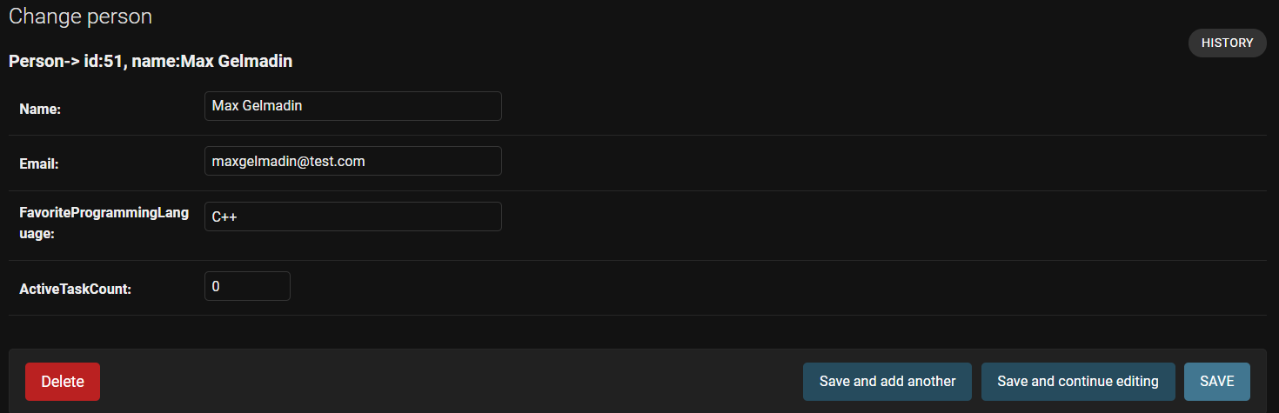
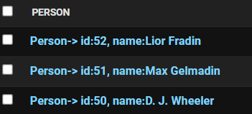
Pros
Admin panel - One of the most powerful parts of Django is the automatic admin interface. It reads metadata from your models to provide a quick, model-centric interface where trusted users can manage content on your site. The admin’s recommended use is limited to an organization’s internal management tool.

Slide 16
Pros
The MVC model in Django:
Controller. A controller is the heart of the system, it steers everything. For a web framework, this means handling requests and responses, setting up database connections and loading add-ons. For this, Django reads a settings file so that it knows what to load and set up. And Django reads a URL config file that tells it what to do with the incoming requests from browsers.
Model. The model layer in Django means the database plus the Python code that directly uses it. It models reality. You capture whatever your website needs in database tables. Django helps you write Python classes (called models) that tie 1:1 to the database tables.
View. The view layer is the user interface. Django splits this up in the actual HTML pages and the Python code (called views) that renders them. And it also has an automatic web admin interface for editing the models.

Slide 17
Cons
Very strict working convention with Django framework. Thus, any deviation is bug prone.
For example:
We decided to add a home page when entering the website (127.0.0.1:9000).
This page contains some explanation about the project and how to use its features.
To clarify things, we wanted to add an image that depicts the API of the project.
Apparently, the regular convention of displaying an image in HTML did not work and
we were required to create a very specific path that allows Django to load images.
Django includes many functionalities that remain unused in small project like our own.
For example:
The setting.py file that includes security libraries for security checks
(session and key authentication) that are not required during this project.

